Slide 1
Draw A Piece
By:
Anthony Assi
Daniel Ingersoll
Daniel Kimmelmann
Raul Moncayo
Raman S. Nakarmi

Slide 2

Main Objective:
Draw a Piece is a drawing web application, that allows users to draw across multiple canvases and stitch them together.

Slide 3
Goals:
Allow multiple users to work on a common project managed through save states.
Rearrange each block to create different variants of a final image.
Allow users to download individual blocks or image as a whole.
Sprint Overview

Slide 4
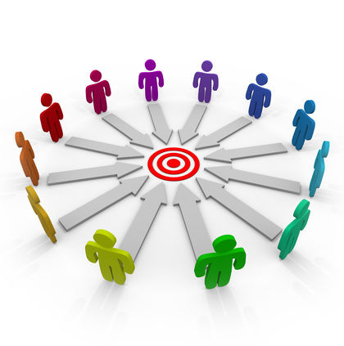
Initial Aims
Provide users with a robust canvas that lets them draw with/without a background image.
Provide users with an application that is able to handle multiple other users participating at the same time.
Provide users the ability to communicate with each other through some chat system.

Slide 5
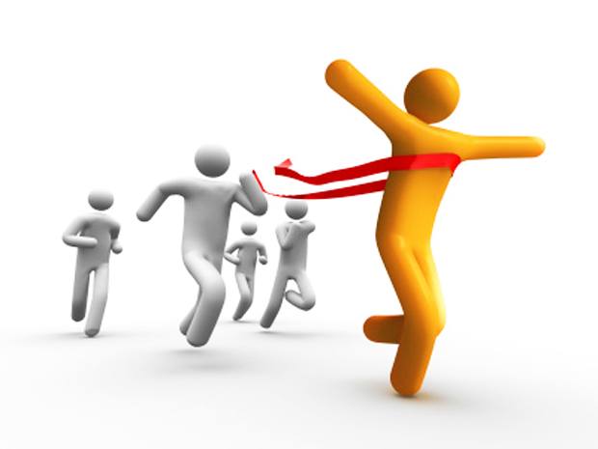
Final Achievements
A drawing app that provides the user with a canvas to draw in, and allows them to have multiple save states and version control to revert back to.
A saving system that is not hindered by multiple users saving at the same time (creates separate saves per user to handle this)
Storing the works of users into database in a sound manner, so that it can be revisited at a different time.
Providing proper authentication features, such that both privacy and publicity is not an issue.

Slide 6
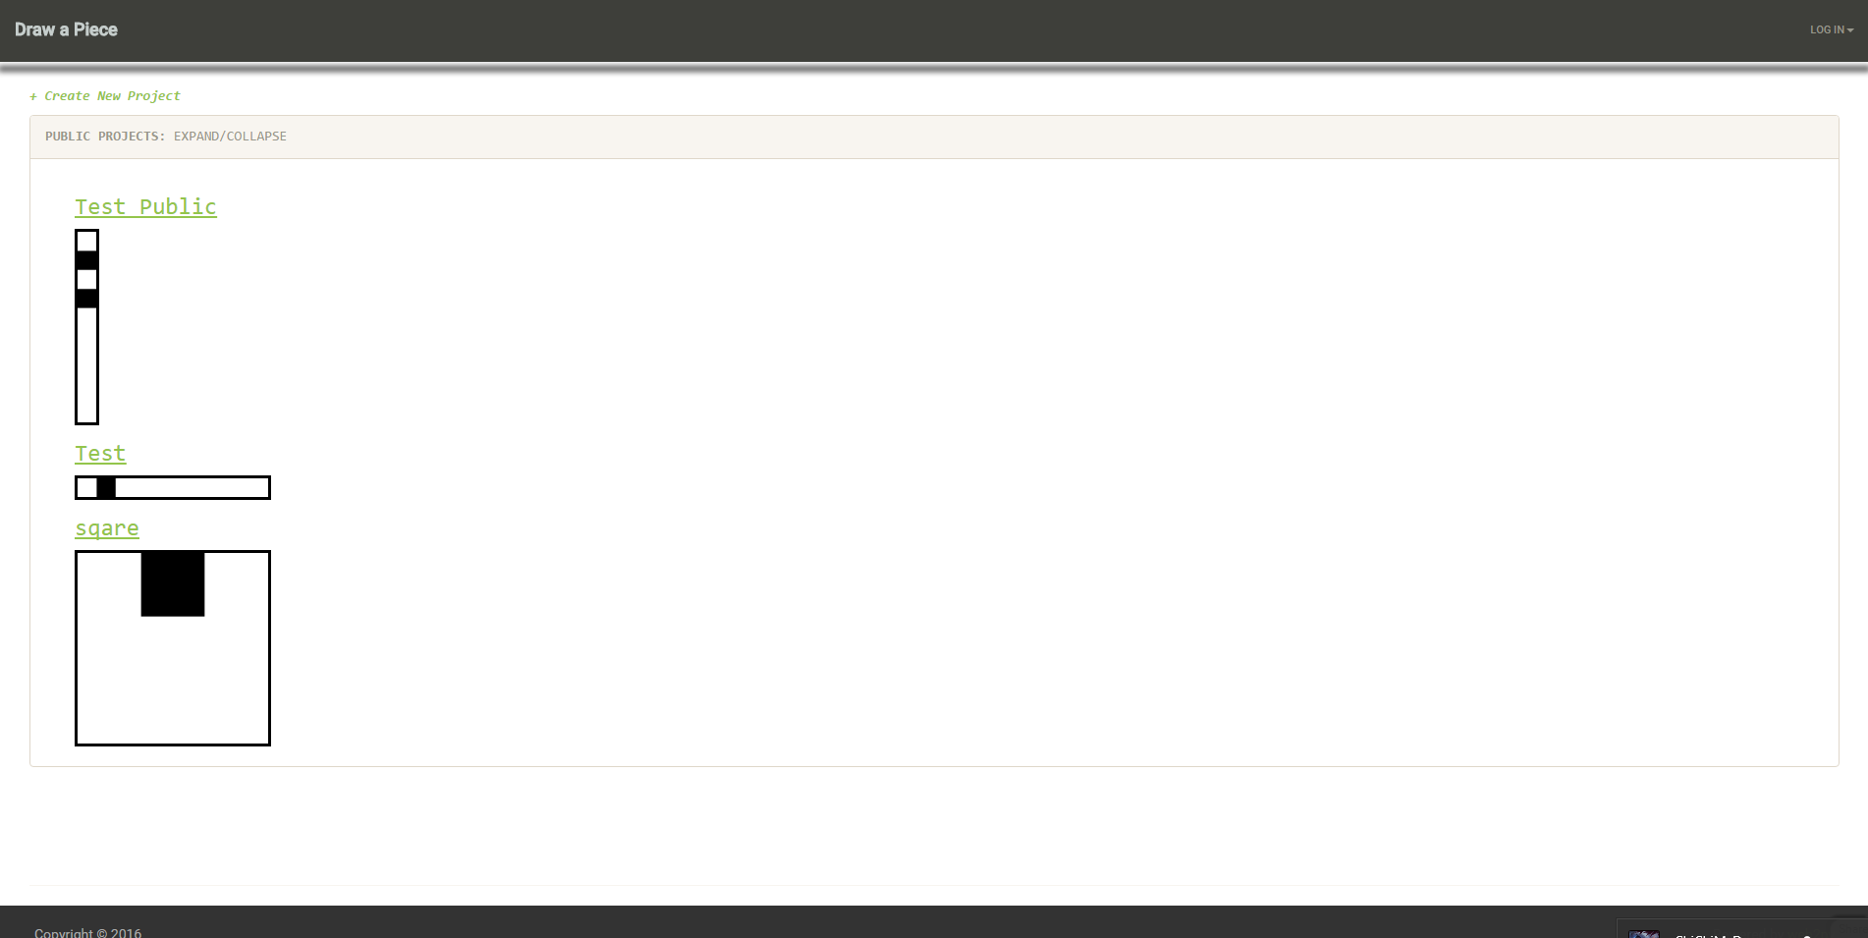
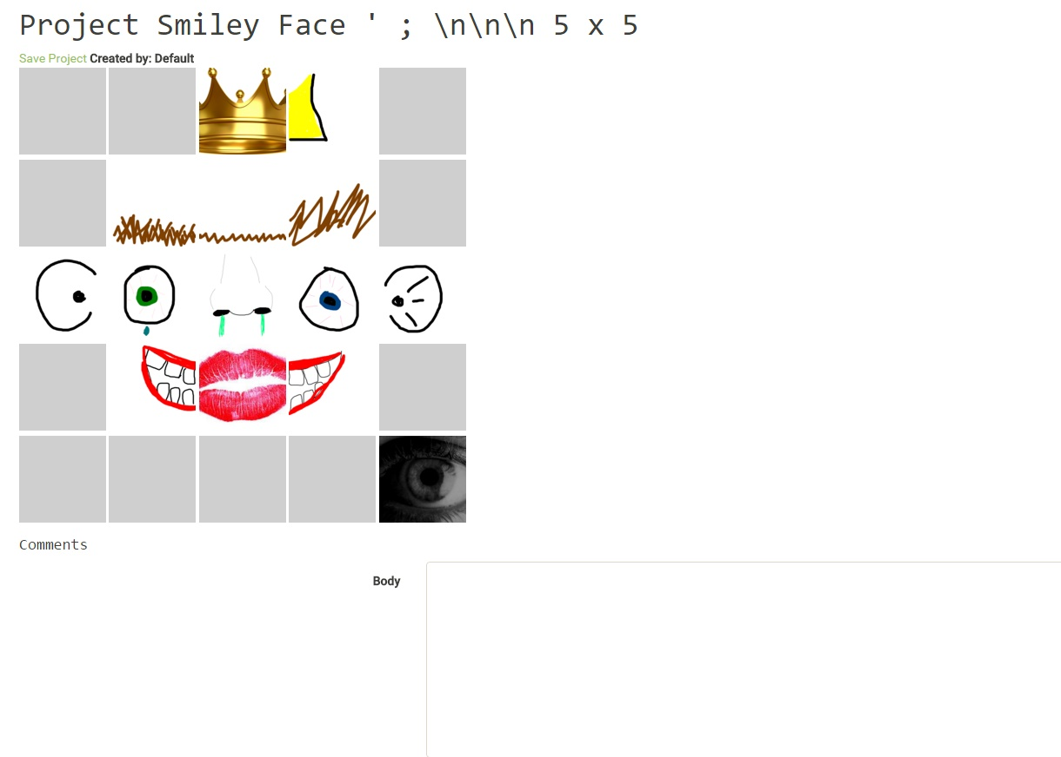
A few ScreenShots: Project Creation

Slide 7
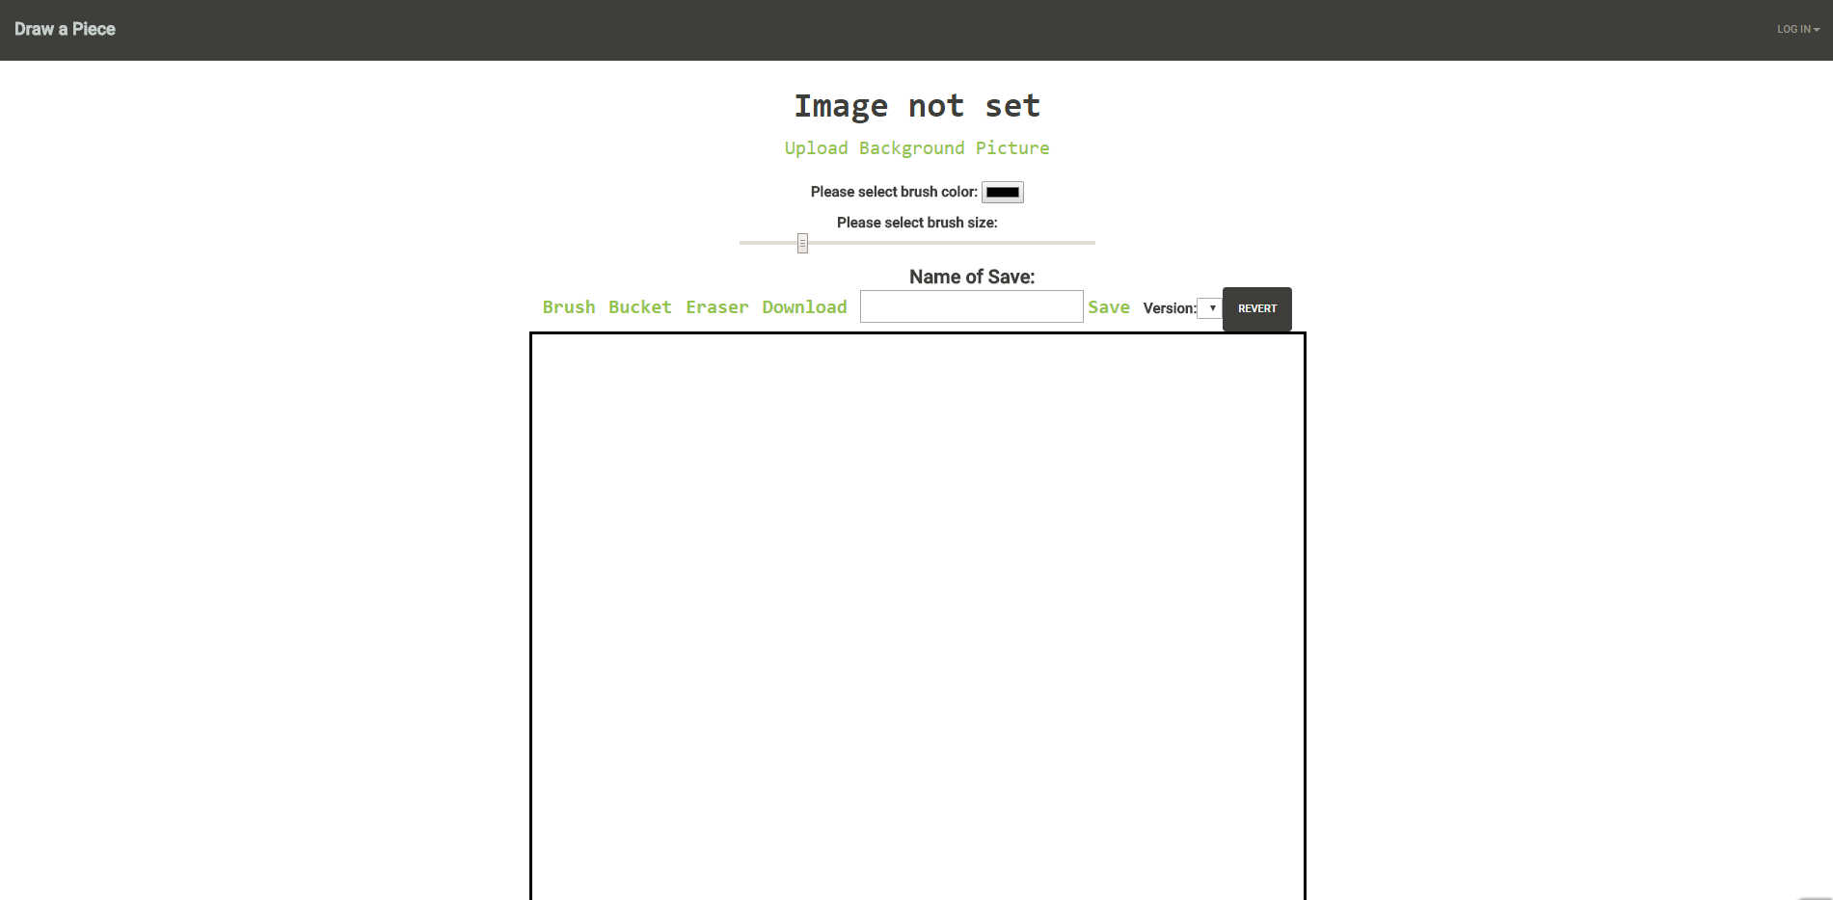
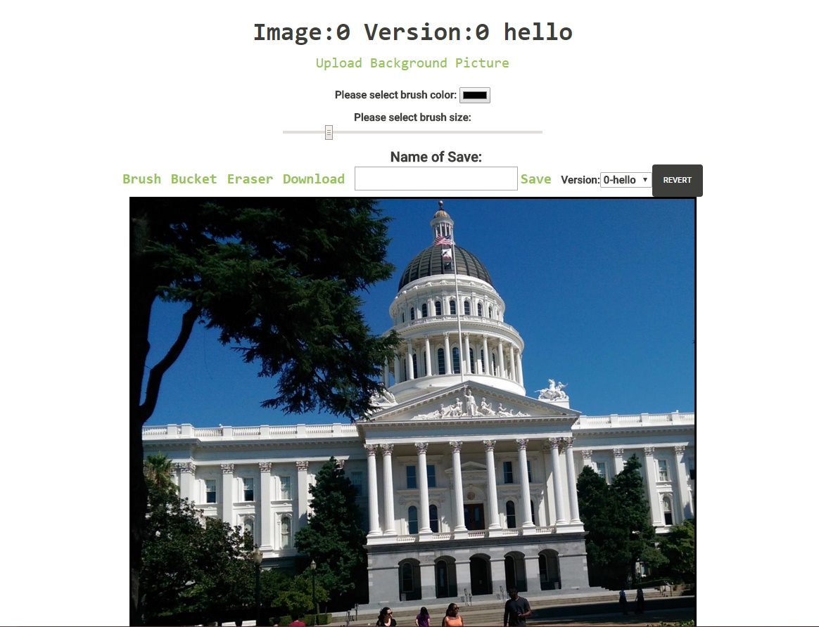
The Canvas: Background and Save States

Slide 8
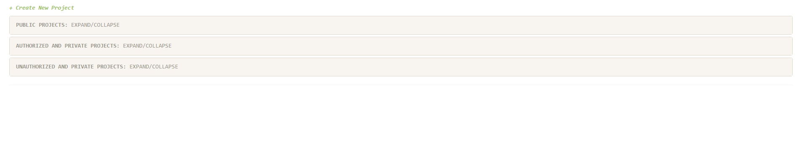
Private and Public Tabs

Slide 9
Challenges:
Familiarizing ourselves with the Web2Py technology and understanding its intricacies.
For some this was the first time we had worked on web applications so we had to learn a few common practices.
Picking up new programming languages to meet the group needs.
Underestimating the difficulty of task in the beginning stages.

Slide 10
Adapting with difficulty
We had to change the way we did certain for convenience, security or difficulty issues.
We had to realize what features were the most important amongst others.
Letting go of some features that were not fundamental due to time constraints.
Some tasks seemed trivial but proved to be rather difficult,as a result we spent more time than we had.

Slide 11
The Good and the Bad
The Good:
Manufacturing a web application for the first time.
Working with new technologies.
Learning new programming techniques.
Overcoming obstacles through clear communication.
Seeing an application grow and develop through the sprints.
The Bad:
Finding a place to start.
Time spent understanding web2py.
Sometimes not all sprints goals were fully met.
A few overestimation issues.
Notes:
anthony

Slide 12



Technologies Used
Web2py
HTML, CSS, JavaScript,Bootstrap
Python Image Library
PythonAnywhere
Notes:
anthony

Slide 13
Working Together
Communicating with each other through social media to update the group on progress. People were constantly communicating issues and progress.
Use SCRUM methodology to manage our project.
Updating Scrum boards on Trello to keep track of progress.
Comment each change on GitHub for clarification.
Notes:
anthony

Slide 14
The Draw A Piece Website!

